Slide 1

Amazon Business Performance Report
This presentation will delve into your Amazon Sales Report.csv, providing a comprehensive analysis to identify key performance drivers and actionable strategies for enhanced business performance. We will explore sales trends, product popularity, fulfillment efficiency, and geographical distribution to uncover opportunities for optimisation.

Slide 2
Amazon Sales Report Column Descriptions
The Amazon Sale Report.csv contains essential information for a granular analysis of your marketplace performance. Here’s a detailed breakdown of the key columns and their significance.
Column Name
Description & Examples
Order ID
Unique identifier for each Amazon order (e.g., 405-8078784-5731545). Crucial for tracking individual transactions.
Date
Date of order placement or processing (MM-DD-YY). Essential for time-series analysis and trend identification.
Status
Current order status (e.g., Cancelled, Shipped - Delivered to Buyer, Shipped - Returned to Seller). Provides insight into order lifecycle and potential issues.
Fulfilment
Indicates who fulfilled the order: Merchant (seller ships directly) or Amazon (FBA). Key for evaluating fulfillment strategy.
Amount
Total order value for that line item (e.g., 499.00). The primary metric for revenue analysis.

Slide 3
Operational Columns: Unpacking Order Logistics & Product Details
Beyond core sales figures, the report provides critical data points on how products reach customers and their categorisation.
Column Name
Description & Examples
Sales Channel
The specific platform where the order was placed, typically Amazon.in. Useful for understanding multi-channel performance if applicable.
ship-service-level
Type of shipping service selected by the customer (e.g., Expedited, Standard, Same Day). Informs shipping preference and cost analysis.
Category
Product category (Apparel, Electronics, Home). Essential for product performance and portfolio analysis.
Size
Product size information (e.g., M, L, XL, Free Size). Relevant for apparel and other size-specific products.
Courier Status
Current shipping progress (Shipped, Delivered, Returned). Provides real-time insights into delivery success and issues.
Qty
Quantity of items in the order (1, 2, etc.). Used for calculating total units sold and average items per order.
currency
Currency used for the transaction (INR). Standardises monetary values for analysis.

Slide 4
Geographical & Business Dimensions: Pinpointing Customers & Opportunities
Understanding where your customers are located and the nature of their purchases is vital for targeted marketing and logistical planning.
Column Name
Description & Examples
ship-city
Destination city for the shipment. Granular location data for urban targeting.
ship-state
Destination state for the shipment. Essential for regional sales performance and policy compliance.
ship-postal-code
Postal/ZIP code of the customer’s shipping address. Further granular location data for hyper-local analysis.
ship-country
Destination country (IN for India). Confirms the geographical scope of sales.
B2B
Indicates whether the order is Business-to-Business (TRUE) or not (FALSE). Crucial for segmenting commercial vs. retail sales.
fulfilled-by
Confirms the fulfillment party (Amazon, Merchant). Redundant with Fulfilment but can serve as a cross-reference.
Note: index, New, and PendingS columns are likely internal system fields or derived metrics. Their utility for business analysis needs further investigation to confirm their relevance.

Slide 5
Dashboard Design: Amazon Sales Insights

Slide 6
OVERVIEW
Key Objectives for Data-Driven Decisions
1
2
Sales Performance & Trends
Product Analysis
Understand overall sales, identify trends, and recognise patterns over time to forecast future performance.
Analyse product category, size, and quantity distribution to pinpoint popular items and inform inventory decisions.
3
4
Fulfillment Efficiency
Geographical Distribution
Investigate fulfillment methods to assess their effectiveness in order delivery and identify areas for improvement.
Explore sales distribution across states and cities to optimise regional marketing and logistics.
Our aim is to provide actionable insights and recommendations based on this analysis to optimise sales strategies, enhance customer satisfaction, and improve overall business performance.

Slide 7
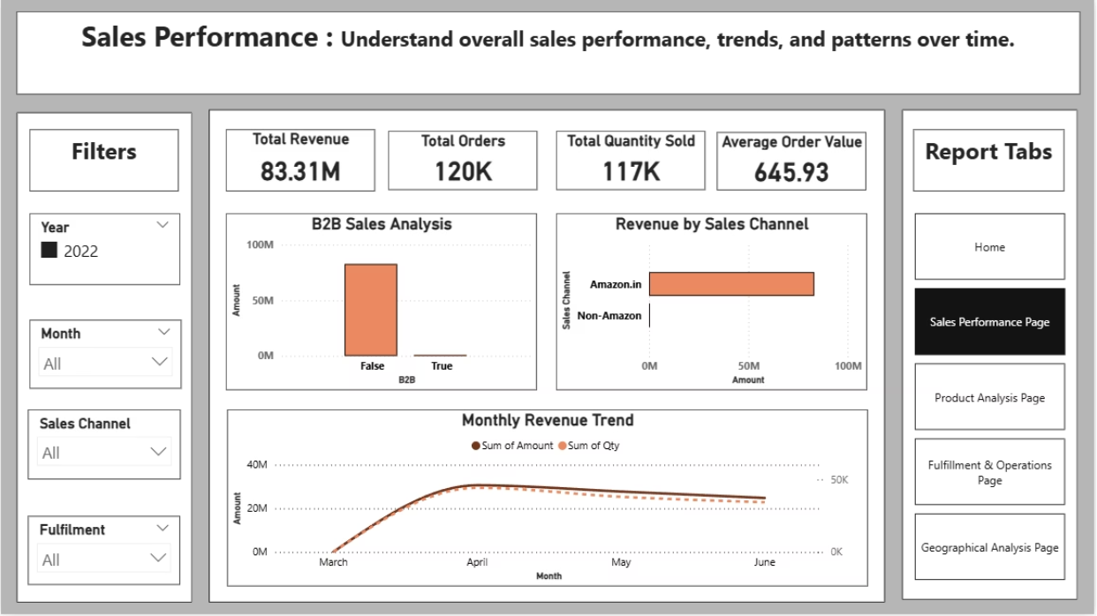
Sales Overview - Performance at a Glance
The initial page of our dashboard focuses on providing a holistic view of your sales performance. This will serve as the foundation for deeper dives into specific aspects of your business.
Key Performance Indicators (KPIs):
Total Revenue
Total Orders
Average Order Value (AOV)
Total Quantity Sold
Key Visualisations:
Line Chart: Revenue trend over time (daily/weekly/monthly). Identifies seasonality and growth trajectory.
Bar Chart: Total revenue contribution across different sales channels.
Column Chart: Breakdown of sales performance for business-to-business transactions.

Slide 8
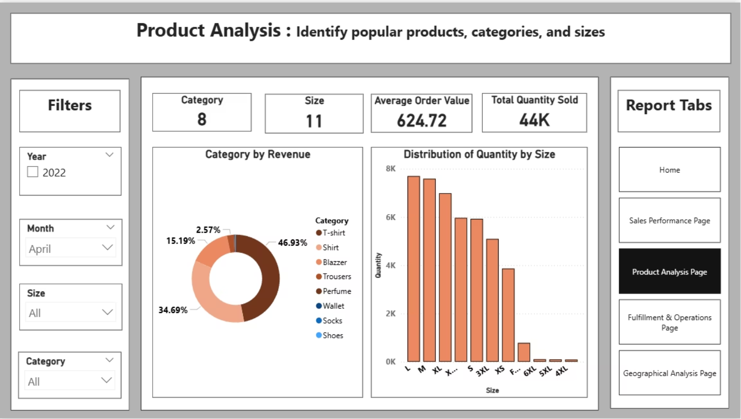
Product Analysis - Uncovering Popularity & Profitability
This page will provide insights into your product portfolio, helping you understand which products are driving sales and how categories contribute to overall revenue.
Key Performance Indicators (KPIs):
Category
Size
Average Order Value (AOV)
Total Quantity Sold
Key Visualisations:
Donut Chart: Breakdown of sales revenue by product category.
Column Chart: Quantity sold by size. Crucial for inventory management, especially for apparel or size-dependent products.

Slide 9
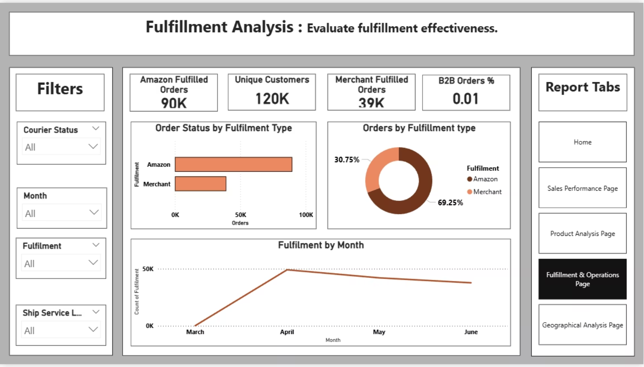
Fulfillment Analysis - Optimising Delivery & Returns
Efficient fulfillment is paramount for customer satisfaction. This page will compare fulfillment methods and their impact on delivery success and return rates
Key Performance Indicators (KPIs):
Amazon Fulfilled Orders
Customers
Merchant Fulfilled Orders
B2B Orders %
Key Visualisations:
Donut Chart: Orders by Fulfillment type (Amazon vs. Merchant). Shows the distribution of fulfillment responsibilities.
Stacked Bar Chart: Order status by fulfillment type. Compares success and failure rates between Amazon FBA and Merchant fulfilled orders.
Line Chart: Delivery trend by fulfillment over time. Monitors the consistency of each fulfillment method.

Slide 10
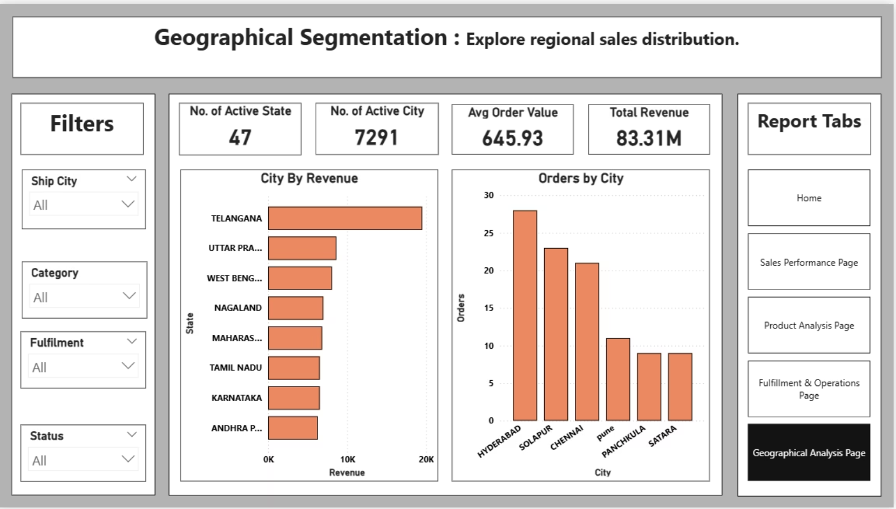
Geographical Analysis - Targeting Regional Markets
Understanding the geographical distribution of your sales helps in optimising marketing campaigns, inventory placement, and logistics network.
Key Performance Indicators (KPIs):
No. of Active States
No. of Active City
Avg Order Value
Total Revenue
Key Visualisations:
Stacked Column Chart: Orders by city. Shows urban centers with high order volumes.
Stacked Bar Chart: Top 10 City by revenue. Identifies the most lucrative states for focused strategies.

Slide 11
Conclusion
Content:
Amazon Sales Dashboard provided clear insights into revenue, fulfilment, customer behavior, and geography.
Data-driven decisions can improve efficiency, customer satisfaction, and business growth.
Future scope includes predictive analytics and automated refresh for real-time monitoring.

